Slide 1

Eternal Blue
Presented By: Rohit Anantha

Slide 2
Presentation Timeline
What?
Who?
Counter?

Slide 3

What is Eternal Blue?
“EternalBlue is a cyberattack exploit developed by the U.S. National Security Agency. “

Slide 4
What does that mean?

Slide 5
The NSA’s Security Practices
Find exploits in everything
Use them for their own purposes
Reveal the exploits when it becomes a problem

Slide 6
But what exactly is EternalBlue?
EternalBlue
Microsoft SMBv1
Malicious Code
Eternal Blue is an exploit in one of Microsoft’s servers, allowing for hackers and interested parties to send malicious code that can execute itself.

Slide 7

Who does this affect?

Slide 8
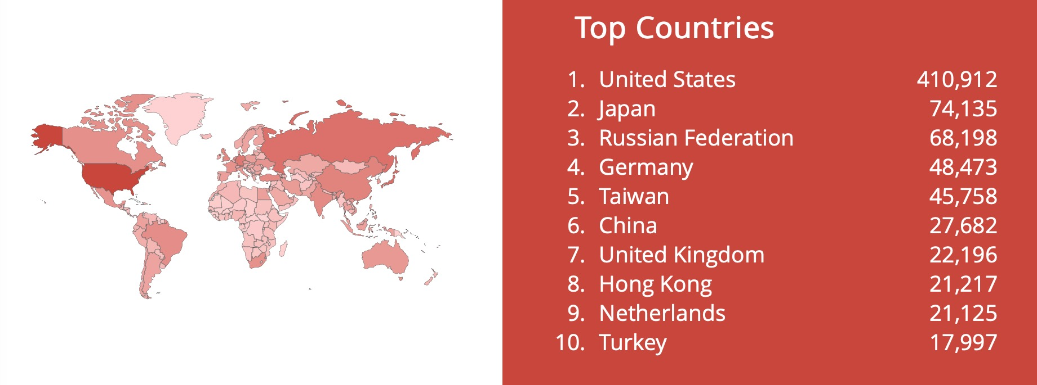
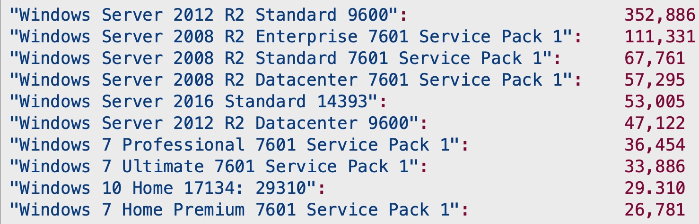
Affected Machines
Server 2012
Server 2008
Server 2016
Server 2012

Slide 9
How can we stay safe?

Slide 10
3. Disable Internet Access
2. Disable SMBv1
1. Security Patch
3 Simple steps:

